Slide 1
Generative Models: Brief on Strengths and Weaknesses
Daniel Khashabi
April 5, 2023

Slide 2

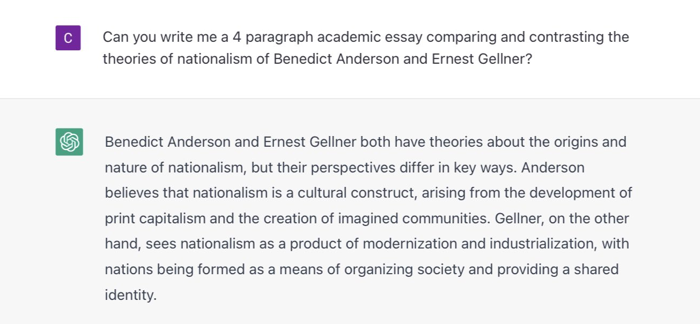
https://chat.openai.com/chat

Slide 3
Self-Supervised Models
Notes:
…. which I am going to spend a few minutes to define.

Slide 4
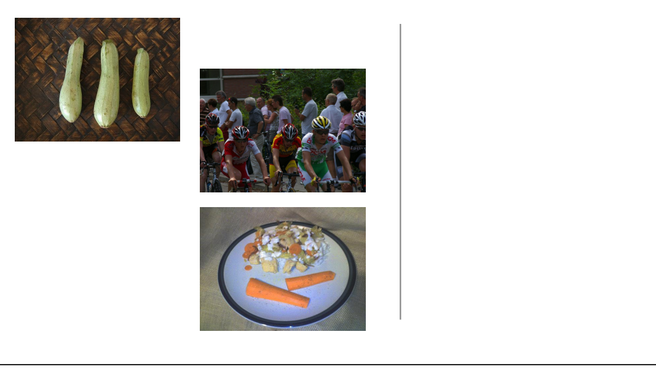
Self-Supervision
[Slide from Colin Raffel]
Notes:
then a few more photos

Slide 5
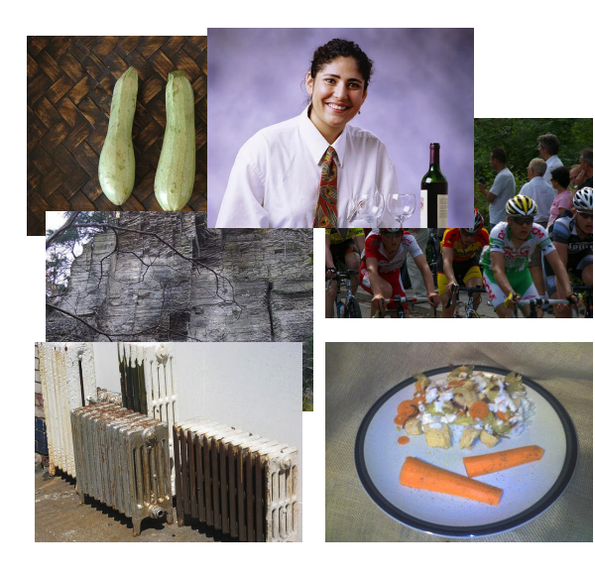
Self-Supervision
[Slide from Colin Raffel]
Notes:
And then a few more photos

Slide 6
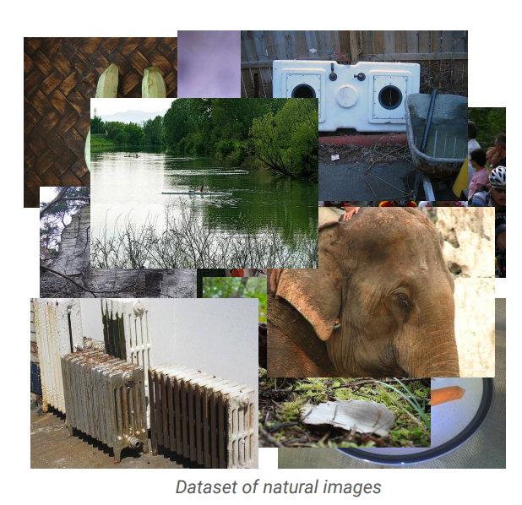
Self-Supervision
[Slide from Colin Raffel]
Notes:
And eventually I have a large collection of natural images.
One can assume that these images are samples from some true distribution - the distribution of natural images.
The goal is to take this training set and learn a model which approximates this true distribution.
That is, I hope to be able to draw new samples from my model which appear like real natural images, but are totally new and are not simply copies of entries from my training set.

Slide 7
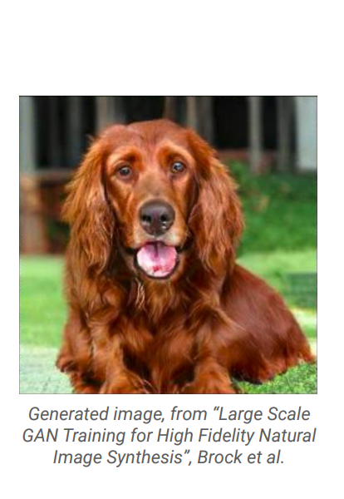
Self-Supervision
[Slide from Colin Raffel]
Notes:
Here's an example of an image produced by a recent generative model developed by some researchers at DeepMind.
The generative model has made up this dog completely on its own.
It has never seen this particular dog before in the training set, either.
To my eyes at least, it's hard to tell that this is a generated image and not a real picture of a dog.

Slide 8
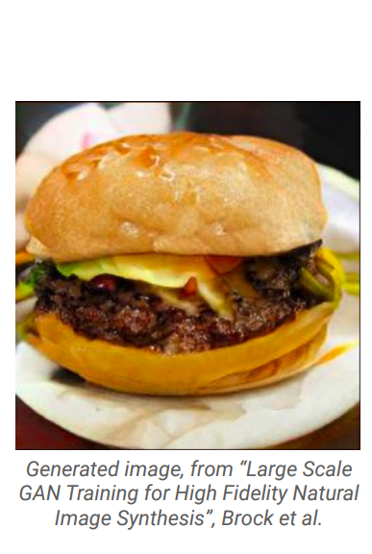
Self-Supervision
[Slide from Colin Raffel]
Notes:
And here's another one.
I for one would be happy to eat this made-up cheeseburger.
The fact that the model is able to produce these images suggests that it has learned about the structure of the natural world.
The model has done this without explicit supervision - it was simply shown millions of images and discovered this structure itself.

Slide 9
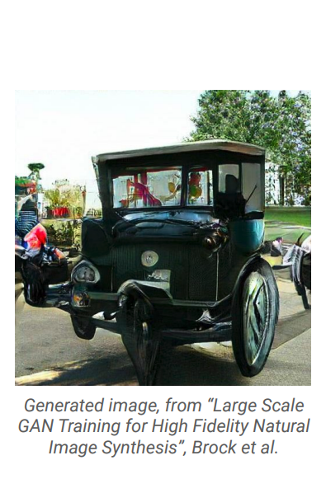
Self-Supervision
[Slide from Colin Raffel]
Notes:
Of course, this model is not perfect -- sometimes it generates things like this quasi-car.

Slide 10
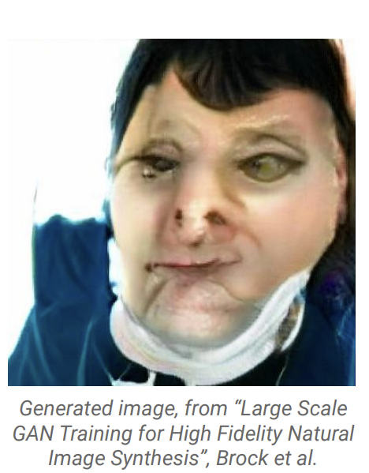
Self-Supervision
[Slide from Colin Raffel]
Notes:
Even worse, it hasn't really figured out what human faces look like.
This is likely because the dataset it was trained on has a relatively low proportion of images of people’s faces.
So while the results are quite impressive, there's still work to be done.

Slide 11
Self-Supervision
== treaty of paris (1763) the treaty of paris, also known as the treaty of 1763, was signed on 10 february 1763 by the kingdoms of great britain, france and spain, with portugal in agreement, after great britain's victory over france and spain during the seven years' war. the signing of the treaty formally ended the seven years' war, known as the french and indian war in the north american theatre, ….
[Slide from Colin Raffel]
Notes:
This same paradigm can be applied to other domains outside of natural images. For example, let's say we collect articles from Wikipedia.

Slide 12
Self-Supervision
== wheelbarrow
A wheelbarrow is a small hand-propelled vehicle, usually with just one wheel, designed to be pushed and guided by a single person using two handles at the rear, or by a sail to push the ancient wheelbarrow by wind. The term "wheelbarrow" is made of two words: "wheel" and "barrow." "Barrow" is a derivation of the Old English "barew" which was a device used for carrying loads. The wheelbarrow is designed to …..
== treaty of paris (1763) the treaty of paris, also known as the treaty of 1763, was signed on 10 february 1763 by the kingdoms of great britain, france and spain, with portugal in agreement, after great britain's victory over france and spain during the seven years' war. the signing of the treaty formally ended the seven years' war, known as the french and indian war in the north american theatre, ….
[Slide from Colin Raffel]

Slide 13

Self-Supervision
== lemon
The lemon (Citrus limon) is a species of small evergreen trees in the flowering plant family Rutaceae, native to Asia, primarily Northeast India (Assam), Northern Myanmar or China.[2] The tree's ellipsoidal yellow fruit is used for culinary and non-culinary purposes throughout the world, primarily for its juice, which has both culinary and cleaning uses.[2] The pulp and rind are also used in cooking and baking. ….
== wheelbarrow
A wheelbarrow is a small hand-propelled vehicle, usually with just one wheel, designed to be pushed and guided by a single person using two handles at the rear, or by a sail to push the ancient wheelbarrow by wind. The term "wheelbarrow" is made of two words: "wheel" and "barrow." "Barrow" is a derivation of the Old English "barew" which was a device used for carrying loads. The wheelbarrow is designed to …..
== treaty of paris (1763) the treaty of paris, also known as the treaty of 1763, was signed on 10 february 1763 by the kingdoms of great britain, france and spain, with portugal in agreement, after great britain's victory over france and spain during the seven years' war. the signing of the treaty formally ended the seven years' war, known as the french and indian war in the north american theatre, ….
Dataset of Wikipedia articles
[Slide from Colin Raffel]
Notes:
Once we have a large dataset of articles …

Slide 14
Self-Supervision
== lemon
The lemon (Citrus limon) is a species of small evergreen trees in the flowering plant family Rutaceae, native to Asia, primarily Northeast India (Assam), Northern Myanmar or China.[2] The tree's ellipsoidal yellow fruit is used for culinary and non-culinary purposes throughout the world, primarily for its juice, which has both culinary and cleaning uses.[2] The pulp and rind are also used in cooking and baking. ….
== wheelbarrow
A wheelbarrow is a small hand-propelled vehicle, usually with just one wheel, designed to be pushed and guided by a single person using two handles at the rear, or by a sail to push the ancient wheelbarrow by wind. The term "wheelbarrow" is made of two words: "wheel" and "barrow." "Barrow" is a derivation of the Old English "barew" which was a device used for carrying loads. The wheelbarrow is designed to …..
== wings over kansas wings over kansas is the second studio album by jason ammons, john bolster and mo rosato. the album debuted at number one on the billboard 200, selling 35,000 copies in it first week at the time. it was the second highest selling album to debut at the billboard top 50 and the third highest selling album to debut at the top heatseekers, with 26,000 copies sold. this is the supremes album earning the nickname …
== treaty of paris (1763) the treaty of paris, also known as the treaty of 1763, was signed on 10 february 1763 by the kingdoms of great britain, france and spain, with portugal in agreement, after great britain's victory over france and spain during the seven years' war. the signing of the treaty formally ended the seven years' war, known as the french and indian war in the north american theatre, ….
Dataset of Wikipedia articles
[Slide from Colin Raffel]
Notes:
we can train a generative model to generate new Wikipedia articles.
In this example. the generated article discusses a made-up album called Wings over Kansas.
The model was only given the title of the article and filled in the rest.
You can see that the model has learned not only basic sentence structure, grammar, and spelling, but also the kind of content which is typical in Wikipedia articles.
It also stays on theme, though it does end up generating some nonsense near the end.

Slide 15
Self-Supervised Models
are predictive models of the world!

Slide 16
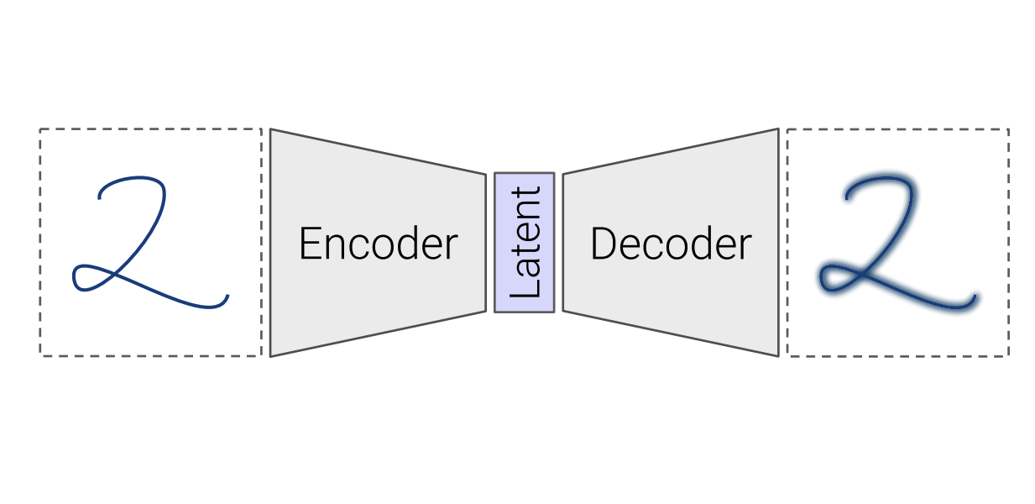
Self-Supervised Models
Are trained to complete partial samples from the world.
Mask
[Bengio et al. 2004, Hinton et al. 2006, Peters et al. 2018, …]
Notes:
These predictive models are trained to fill-in partial instances of the world. To make it a bit more concrete, …

Slide 17
Self-Supervised Models
“Wings over Kansas is an aviation website founded in 1998 by Carl Chance owned by Chance Communications, Inc.”
“Wings over Kansas is [MASK]”
[Bengio et al. 2004, Hinton et al. 2006, Peters et al. 2018, …]

Slide 18
Self-Supervised Models
Are predictive models of the world.
Are learned from unlabeled data.
Notes:
Putting all these together, we get this definition: …
This was my definition of self-supervised models.

Slide 19
Self-Supervised Models
Are predictive models of the world.
Are learned from unlabeled data.
Notes:
Putting all these together, we get this definition: …
This was my definition of self-supervised models.

Slide 20
Self-Supervised Models
Are predictive models of the world.
Are learned from unlabeled data.
Tightly connected to tasks we care about.
Notes:
Putting all these together, we get this definition: …
This was my definition of self-supervised models.

Slide 21

Self-Supervised Models ~ Sponges

Slide 22
Self-Supervised Models ~ Sponges

Slide 23
Self-Supervised Models ~ Sponges

Slide 24
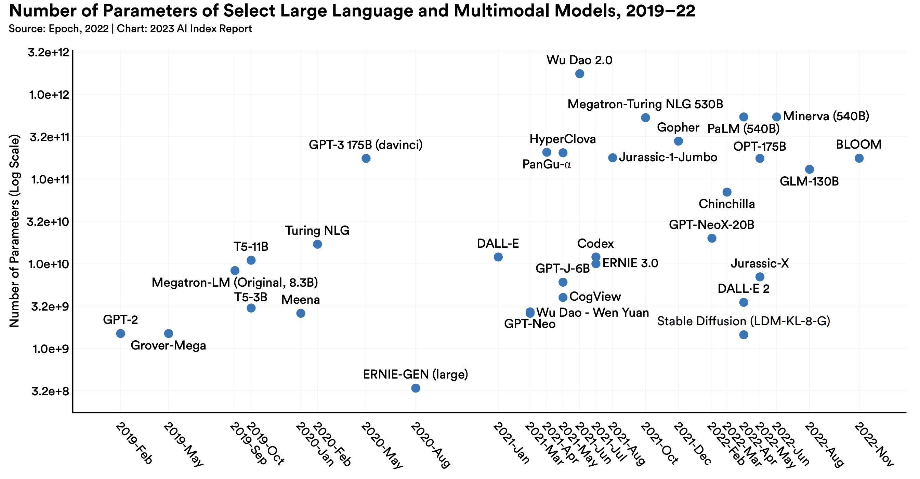
Scaling up the Sponge (Models)
Notes:
https://aiindex.stanford.edu/wp-content/uploads/2023/04/HAI_AI-Index-Report_2023.pdf

Slide 25
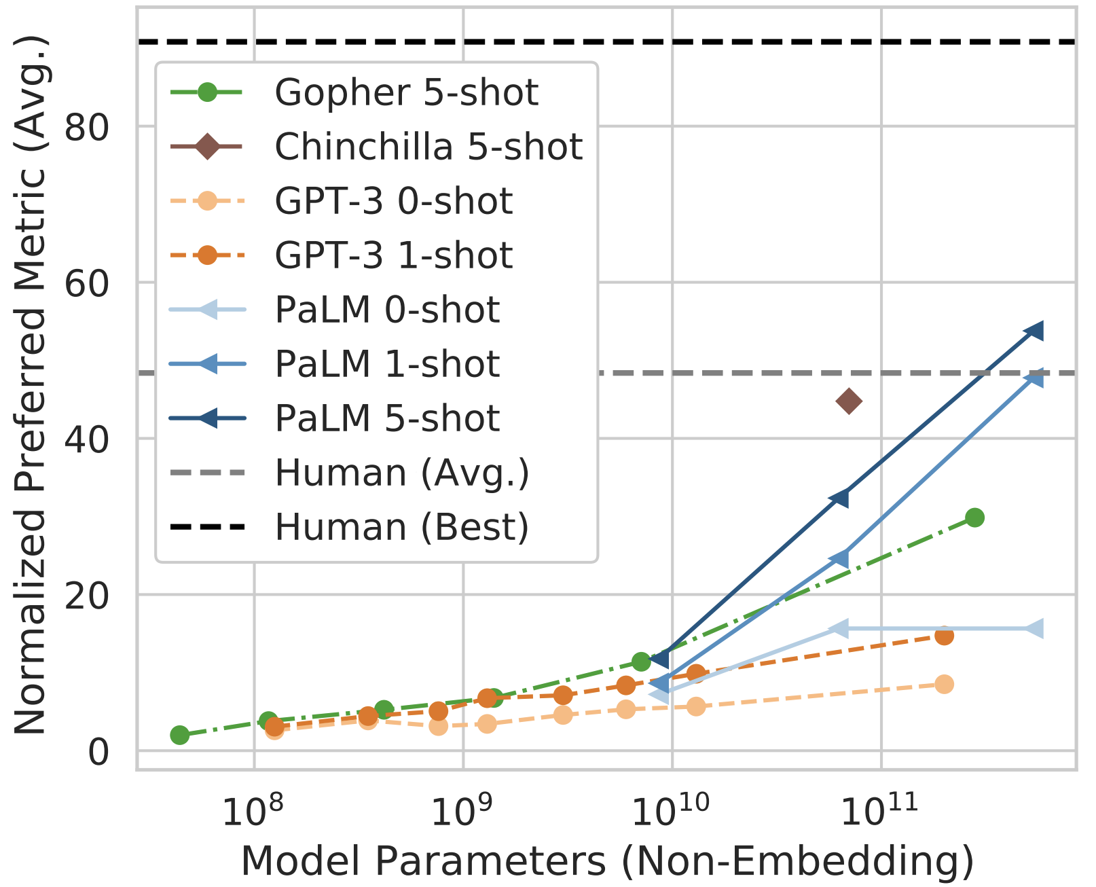
Scaling up the Sponge (Models)
~ Better Quality
Figure credit: Chowdhery et. al., 2022

Slide 26
Try GPT4 Demo!
https://platform.openai.com/playground

Slide 27
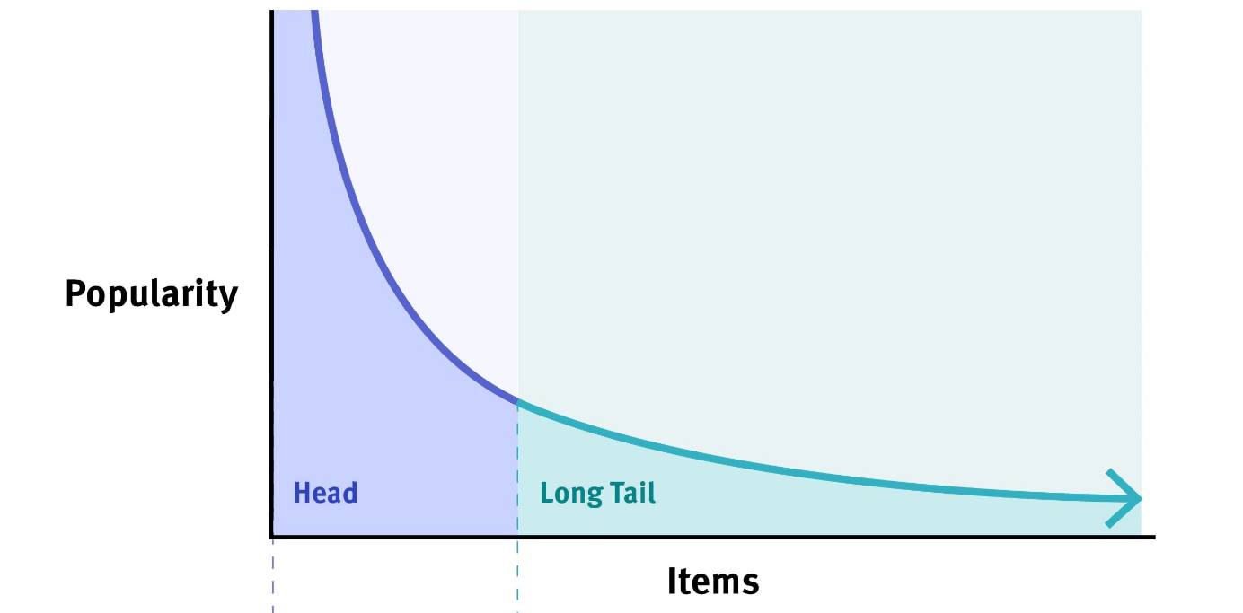
Their Achilles Heel: The long tail Most things are infrequent

Slide 28
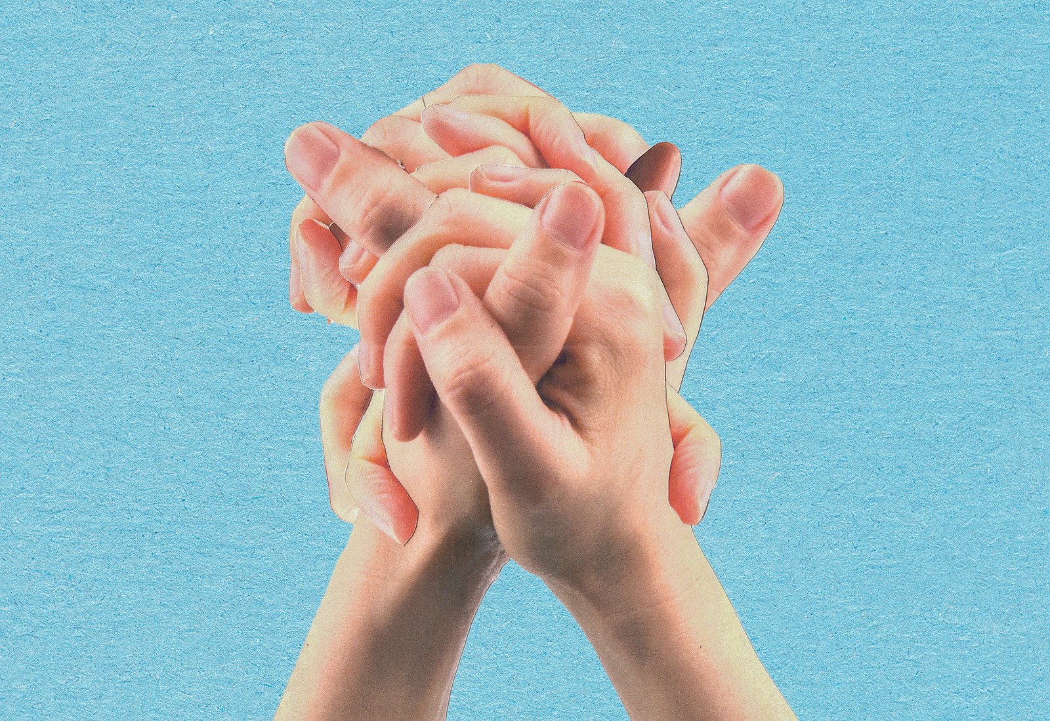
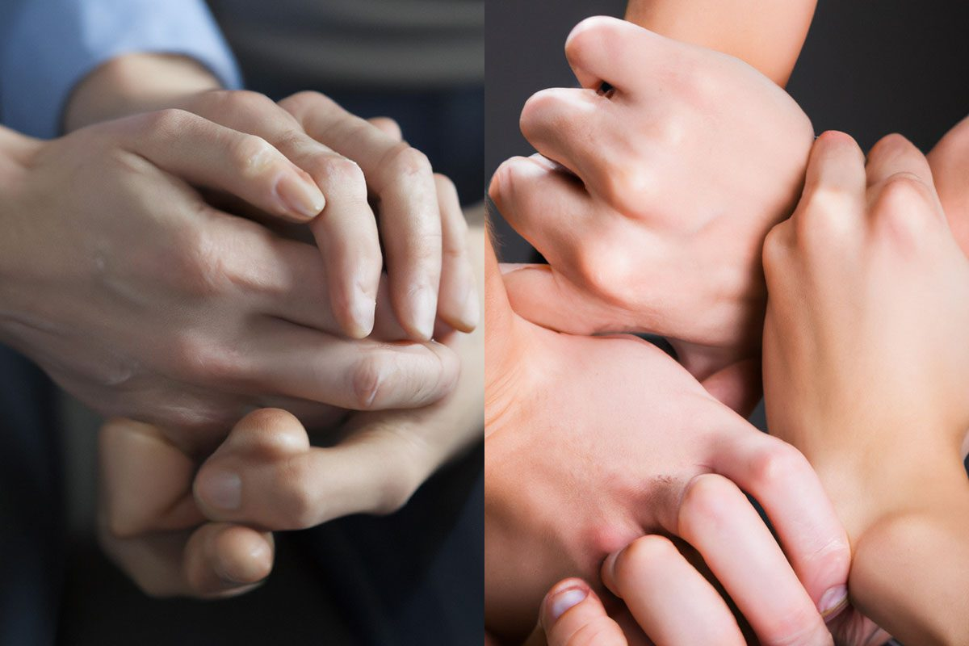
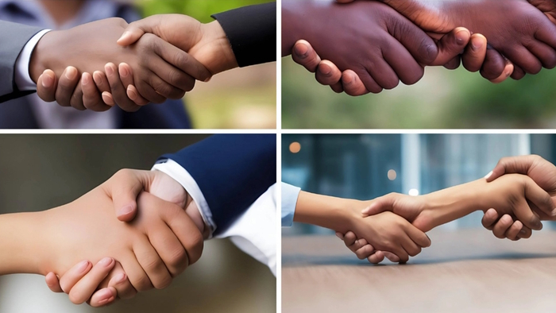
Their Achilles Heel: Models’ quality depend on frequency of patterns

Slide 29
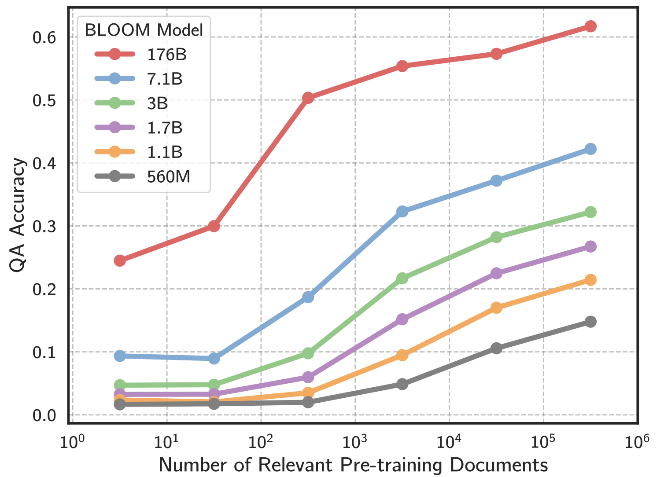
Their Achilles Heel: Models’ quality depend on frequency of patterns

Slide 30
Humans have a long tail too
Consider me as an example.
I know a lot about math and computer science
But there is so much that I don’t know about simply because I haven’t read about them.
👨

Slide 31
Humans have a long tail != machine long tail
Consider me as an example.
I know a lot about math and computer science
But there is so much that I don’t know about simply because I haven’t read about them.
Models read broadly about all topics.
👨 🤖

Slide 32
Humans have a long tail != machine long tail
There is a number after each number.
1 -> 2
142 -> 143
123456788 -> 123456789
There is a number after each number, if they’re small (frequent).
👨 🤖

Slide 33
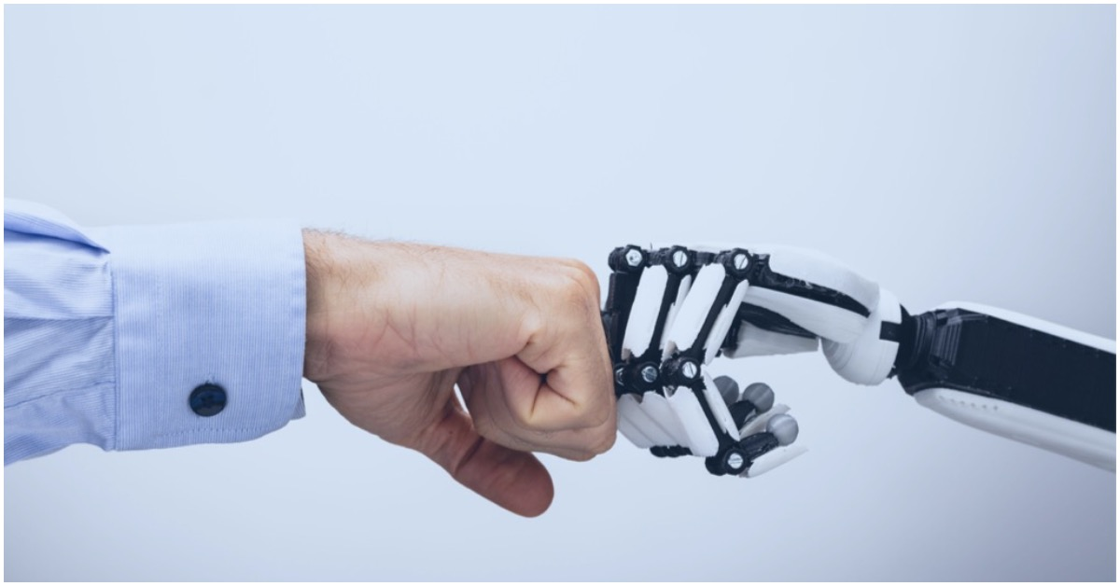
Human-machine complementarity will bring opportunities

Slide 34
Human-machine complementarity will bring opportunities
One needs to identify strengths and weaknesses for forming stable collaboration
Strength/weaknesses ⬄ long-tail

Slide 35
Human-machine complementarity will bring opportunities
Leverage the breadth of machine knowledge for brainstorming (➔ a productivity tool)

Slide 36
Human-machine complementarity will bring opportunities
But be mindful that machines are mostly disconnected from real-world impact/utility.
Why is a certain design is good for a certain need?
How would a certain design may harm certain people?
…
You’re still at the helm!

